Slide 1
Obtaining High-quality Panorama from Videos
Motivation: The technology of stitching a set of images is widely used today. Sometimes we want to obtain a panorama from a video that is captured from a stationary point by rotating the camera. However, the video may suffer from motion blur, which is not wanted when we try to construct a panorama from it. In our project, we try to construct a panorama from a video, and tentatively solve the motion blur problem of the panorama.

Slide 2
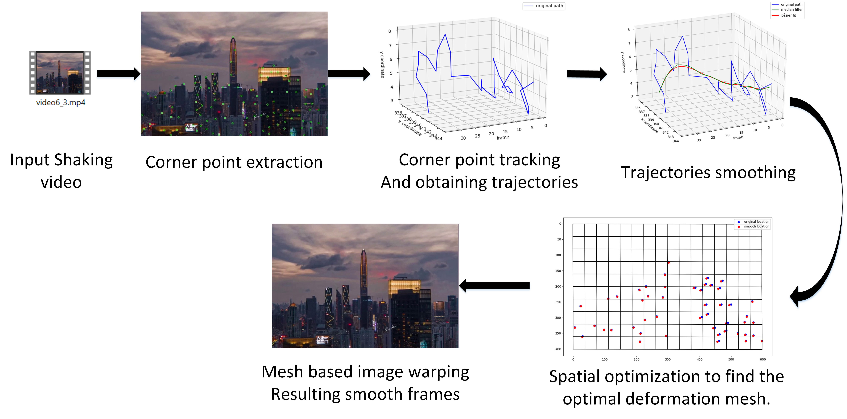
Goal and Methodology
Goal 1: Construct the panorama from a video
Goal 2: Deblur the video to get a high-quality panorama
Pipeline:

Slide 3
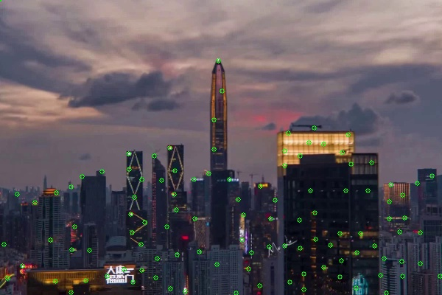
Methodology
1. Corner points detection using SIFT detector
Corner points are detected and update every 5 frames, so that there should be sufficient amount of corner points throughout the whole video even if the lens is moving drastically.
Corner point extraction

Slide 4
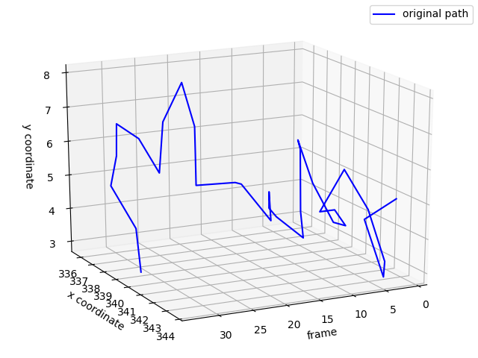
Methodology
2. Homography and warping the image
Corner points location of a specific frame
Track the corner points’ movement from where it appears, and ends while the tracking is failed.

Slide 5
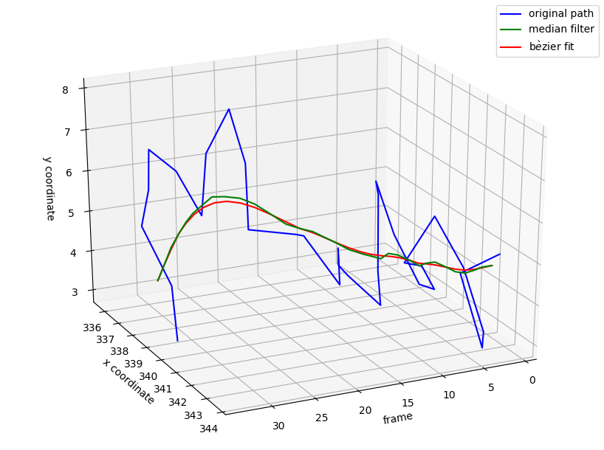
Methodology
3. Video frame selection
Result of Bezier fit has continuous curvature（卷度）.
Trajectories of a specific corner point.
Smooth trajectories.

Slide 6
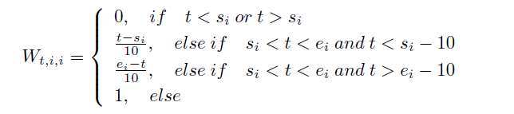
Methodology
4. Cylindrical transformation
Every 5 frames, new corner points will be added, or some corner points are failed to be tracked in the middle of the video. The sudden appearance and vanishment of a corner point would have significant influence to the image deformation results. Therefore, significant values are calculated in order to smooth the influence brought by the new incoming corner point.

Slide 7
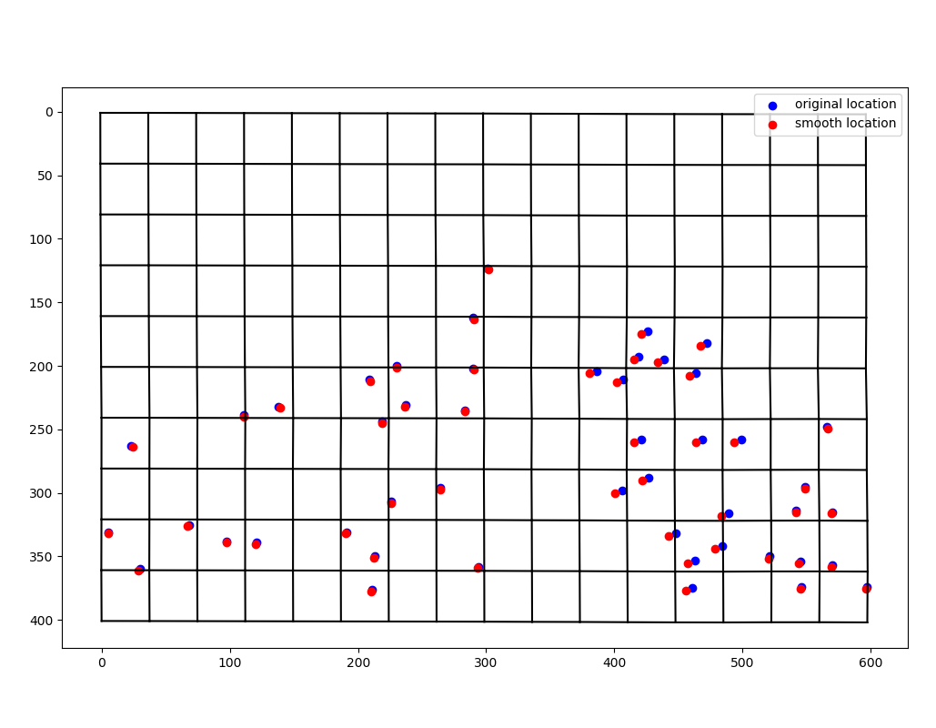
Methodology
5. Calibration of the image
Original and smooth trajectories.
Optimal deformation mesh.

Slide 8
Methodology
6. Deblurring
Step1: Estimating X(t)

Slide 9
Methodology
6. Deblurring
Step2: Deblurring using wiener filter

Slide 10
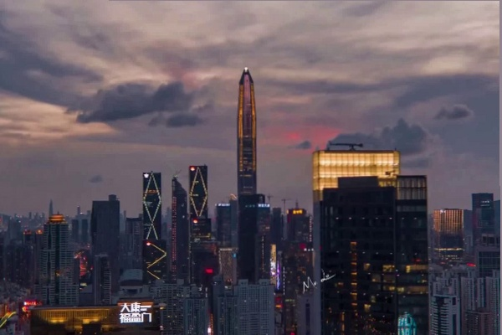
Methodology
6, Apply mesh-based image deformation to all the video frames.
Optimal deformation mesh a specific frame.
Deformation results of a specific frame.

Slide 11
References
Brown, Matthew, Richard Szeliski, and Simon Winder. "Multi-image matching using multi-scale oriented patches." 2005 IEEE Computer Society Conference on Computer Vision and Pattern Recognition (CVPR'05). Vol. 1. IEEE, 2005.
Heckbert, Paul. "Projective mappings for image warping." Image-Based Modeling and Rendering 869 (1999).
Lowe, David G. "Object recognition from local scale-invariant features." Proceedings of the seventh IEEE international conference on computer vision. Vol. 2. Ieee, 1999.

